Slide 1


Predicting employee burnout
Group - 1
Meghavi Singhaniya
Akash Goyal
Bindu Raghu Naga
Alfredo Sandoval
Meenakshi Sundaram

Slide 2
Table of Contents
Problem Statement
Intro to Data
Modelling
Conclusion
Notes:
This is the overall reason why we choose this topic.

Slide 3
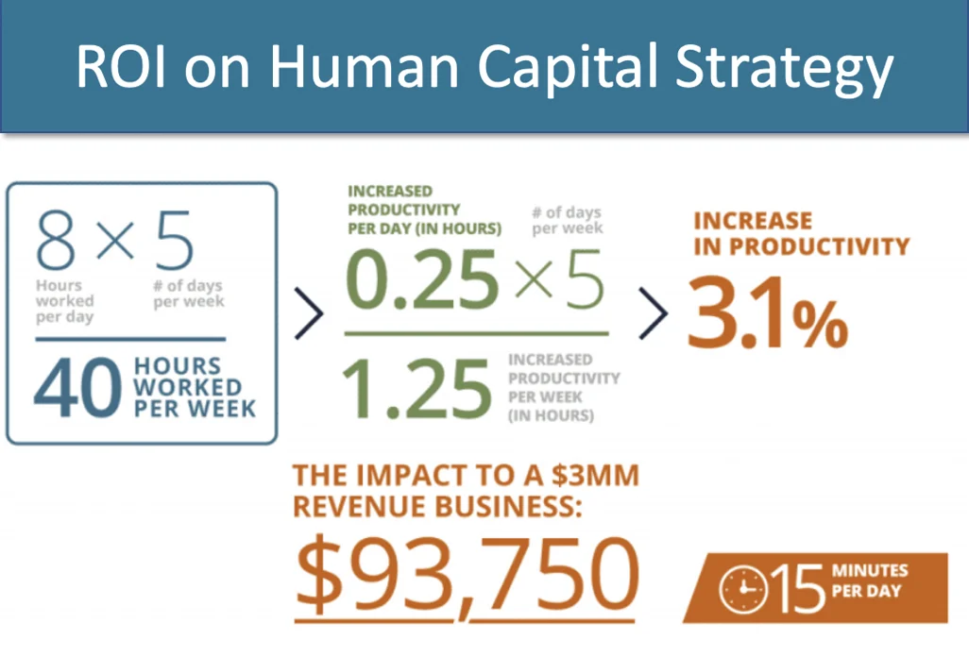

Importance of the problem
"To win in the marketplace, you must first win in the workplace" - Doug Conant
Deloitte’s 2015 external workplace well-being survey found that that three-fourth of employees have felt burnout at certain period.
Notes:
In a typical 40 hour work week, 15 minutes of non-productive, non-billable time equals .25 hours a day, 1.25 hours a week, or 65 total hours a year. For a $3 million business, an increase of productivity of that magnitude translates to more than $93,000 annually.
Just imagine if you could bill 65 more hours a year on a fixed labor cost employee (in other words, generate more revenue with no additional payroll cost). When you multiply that gain across all employees with billable time, your net income would see a hefty increase which would filter down to net profits.
https://www.growthforce.com/blog/understanding-roi-on-human-capital-increase-your-cash-flow

Slide 4
Problem Description
How are employees burn out rate affected based of various factors at workplace?
Does tenure impact employee burnout rate?
Do hybrid workplaces influence employee burnout?
What role does the mental health of the employee play in predicting burnout?
Do executives in higher designation tend to get burnt out more than the ones in junior levels?
Do people who work relatively longer hours feel burnout more than others?

Slide 5
Table of Contents
Problem Statement
Overview of Data
Modelling
Conclusion
Notes:
This is the overall reason why we choose this topic.

Slide 6
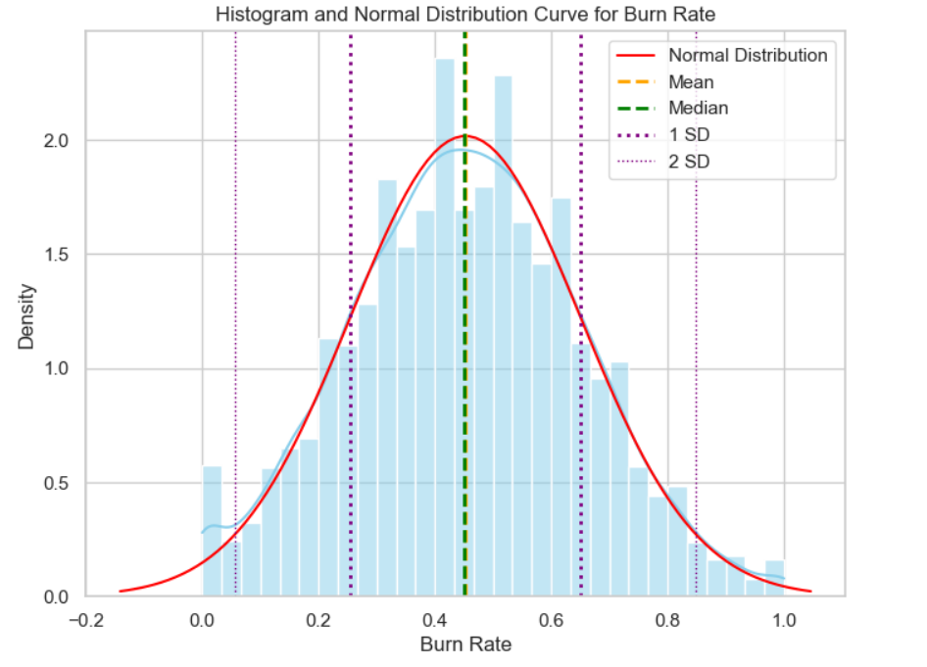
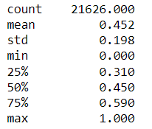
Overview of Data
Dataset includes details about employees who joined the company from 1st Jan to 31st Dec 2008...
22,750 Observations
9 Attributes
Response Variable Burn Rate
Predictors : 8 Attributes
Employee ID
Date of Joining
Resource Available
Mental Fatigue Score
4 Numerical Variables
Gender
WFH Available
Company Type
Designation
4 Categorical Variables
Notes:
Resource Allocation: The amount of resource allocated to the employee to work, ie. number of working hours.
In the range of [1.0, 10.0] (higher means more resource)
Mental Fatigue Score: The level of fatigue mentally the employee is facing.
In the range of [0.0, 10.0] where 0.0 means no fatigue and 10.0 means completely fatigue.

Slide 7

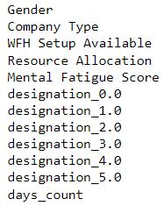
Data Preprocessing:
Data Cleaning
Missing Values
Data Encoding
Mapping
One-Hot Encoding
Create new columns
Days_count
Drop unwanted columns
Employee ID and Date of Joining Variable
days_count: For more readability
max(DOJ) - min(DOJ)
Dropping DOJ variable
One Hot Encoding (Designation)
No measurable unit
Capture any non-linearity
Treat Independently
1 and 0 Mapping (Categorical Predictors)
1) Gender
2) Company Type
3) WFH Setup Available
Drop the missing values
12 Numerical Variables after data preprocessing
22,750 Rows
18,950 Rows
Train-Test Split
70% - 30%

Slide 8
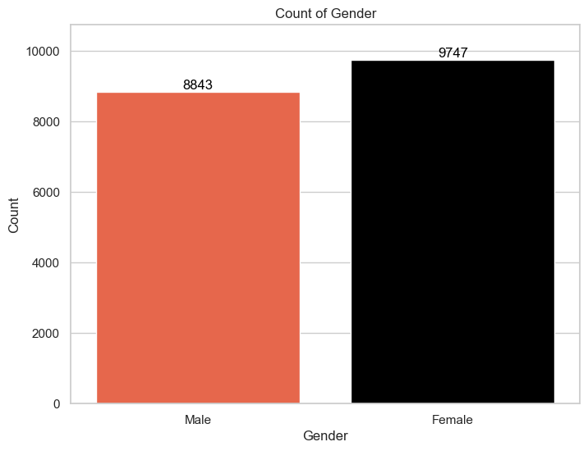
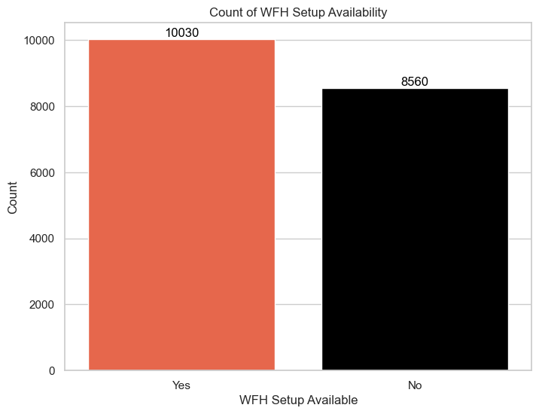
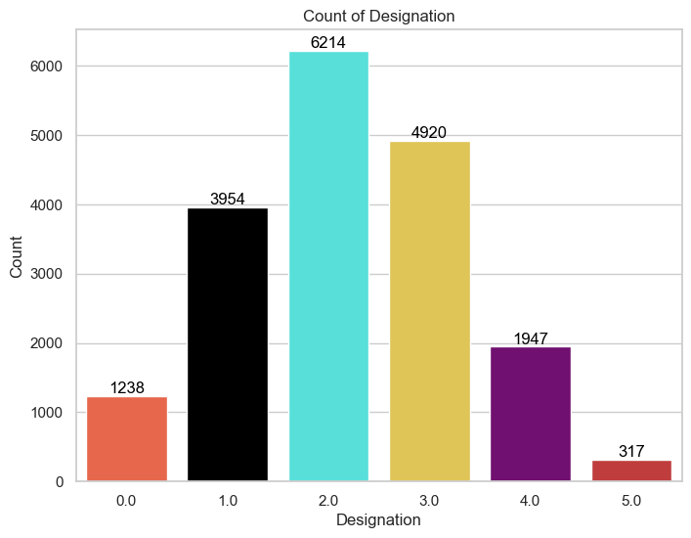
Exploratory Data Analysis.. Distribution of predictor variables
Almost 33% : Designation 2
Only 1.7% : Designation 5
52.4% are female employees
~54% of the employees have the hybrid workplace option

Slide 9
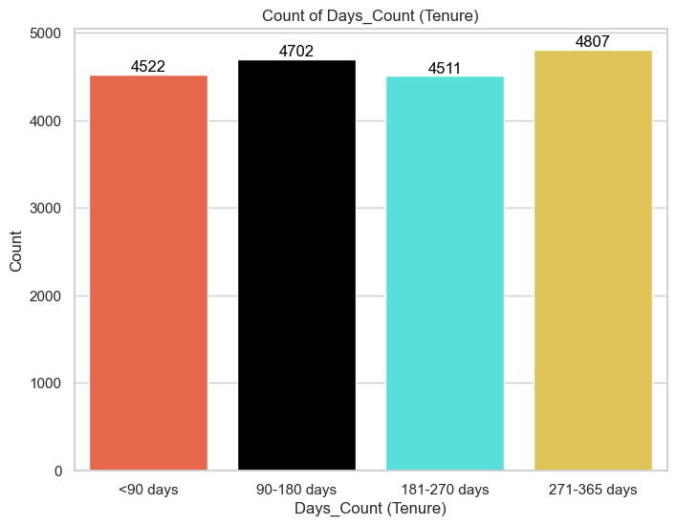
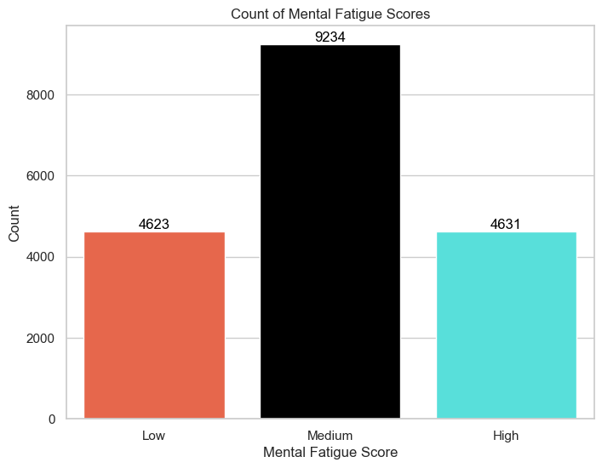
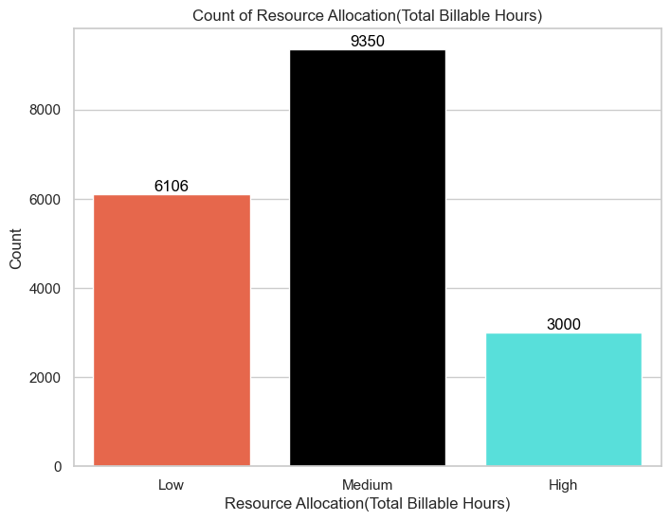
Exploratory Data Analysis.. Distribution of predictor variables (contd.)
Resource Allocation (1 to 10)
Low : < 4hrs
Medium : 4 – 7 hours
High : > 7 hours
Mental Fatigue Score (0 to 10)
Low : 1st quartile range
Medium : Q2-Q3 range
High : 4th quartile range
Days Count: Binned into group of 90 days for more readability

Slide 10
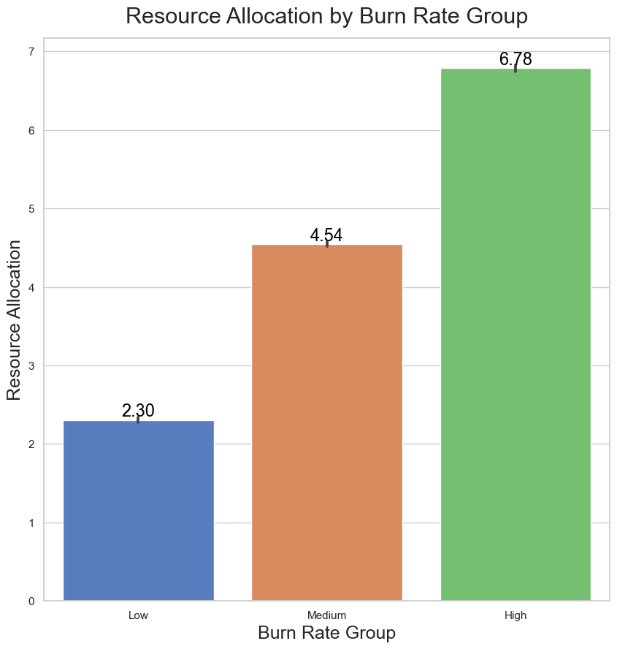
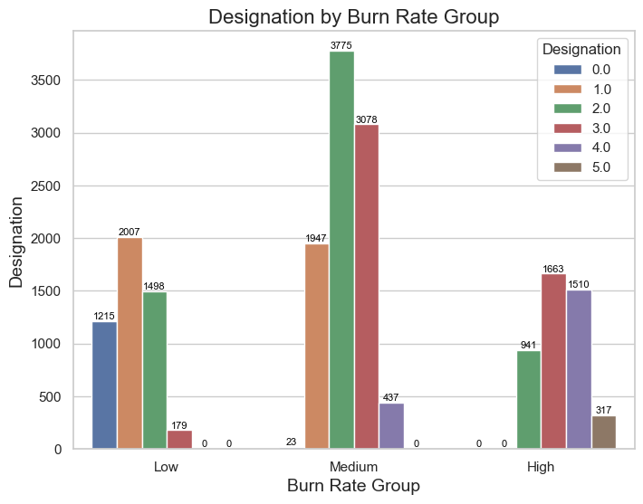
Exploratory Data Analysis... Burn rate profiling by features...
Burn Rate Groups (0 to 10) :
Low : Quartile 1 range
Medium : Quartile 2-3 range
High: Quartile 4
Number of Employees

Slide 11
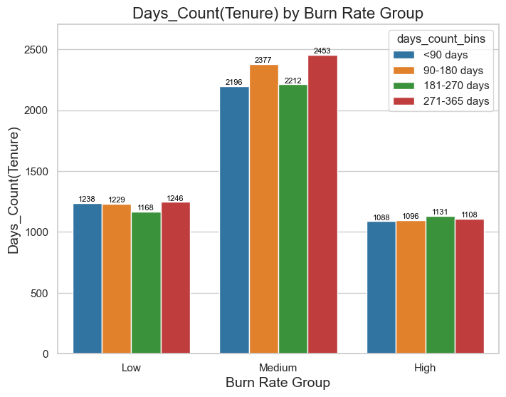
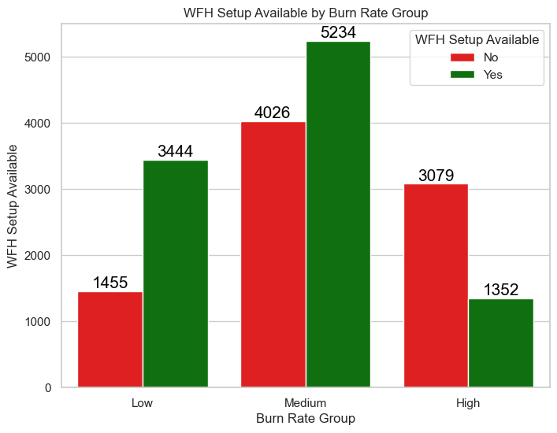
Exploratory Data Analysis... Burn rate profiling by features(contd.)

Slide 12
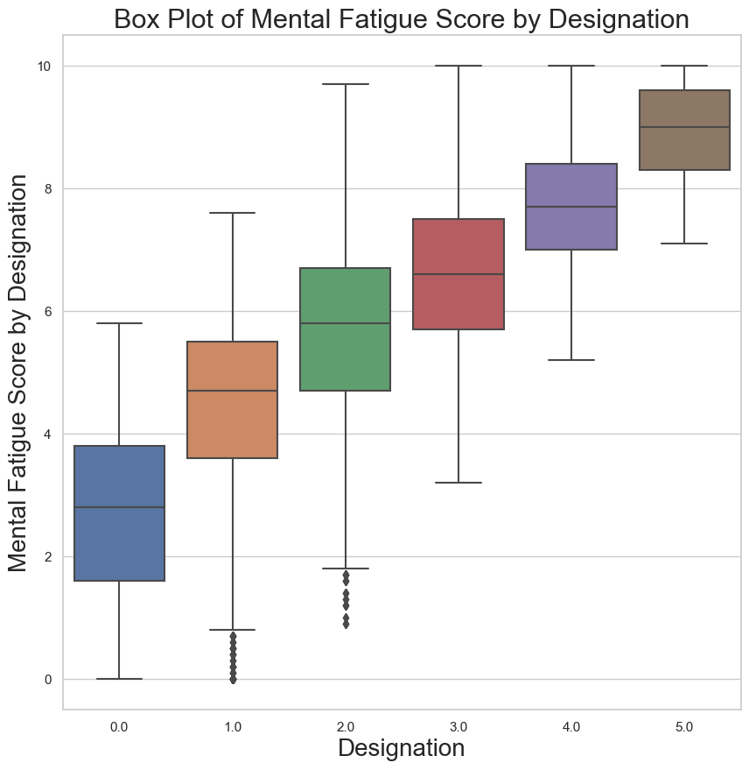
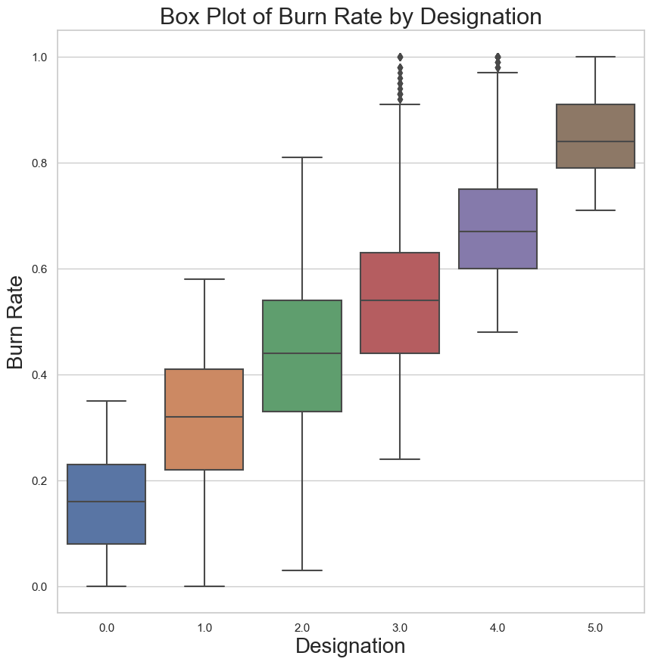
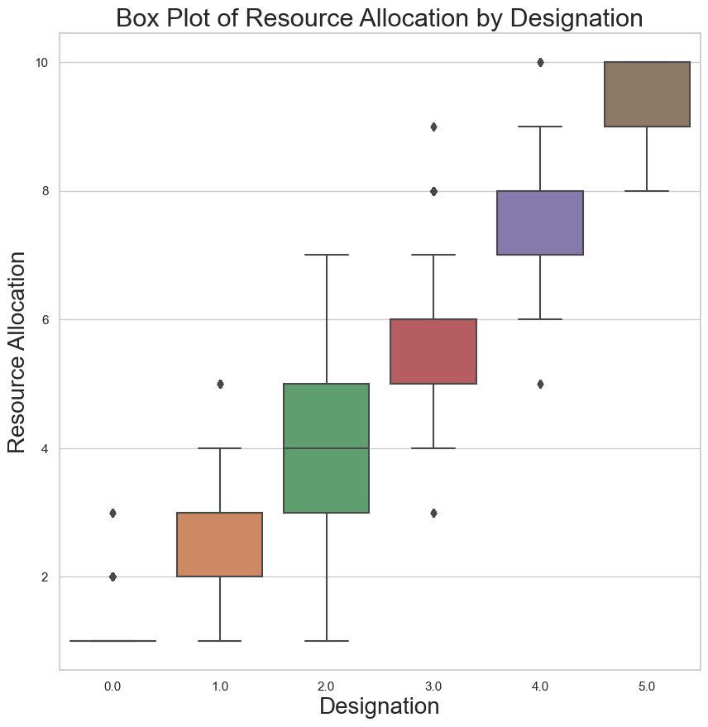
Exploratory Data Analysis... Designation based profiling by features...
Designation Levels 4 & 5 : High Mental Fatigue Score
Designation Levels 5 : Highest Burn Rates
Designation Levels 5 : Long Working Hours

Slide 13
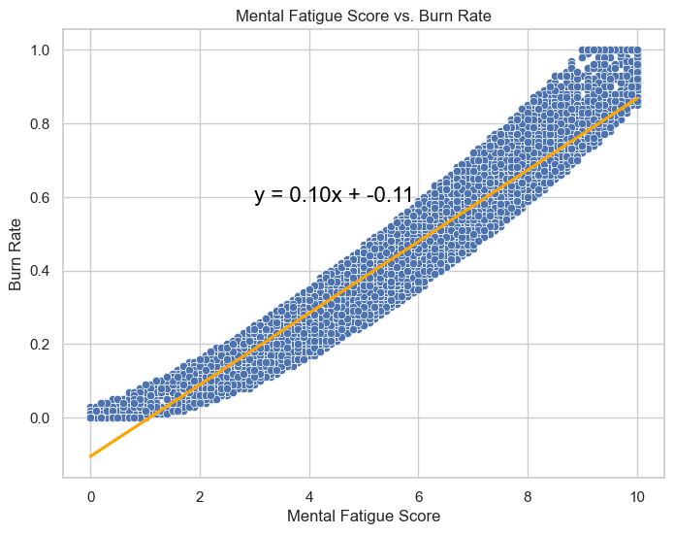
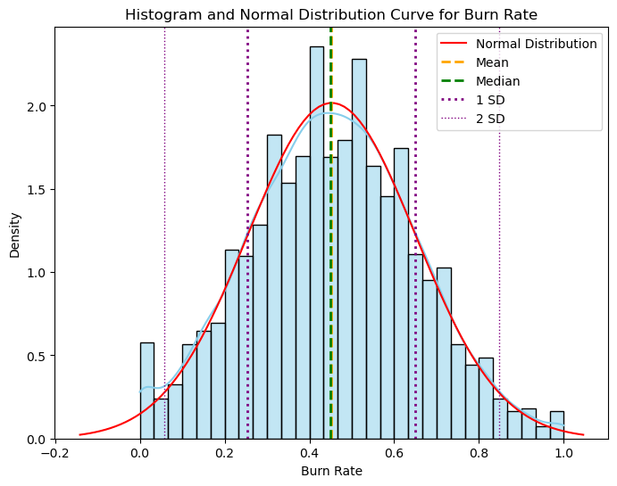
Burn Rate v/s Mental Fatigue Score
Impact Analysis on Burn Rate...
Our Response Variable Burn Rate...
y = 0.10x – 0.11

Slide 14
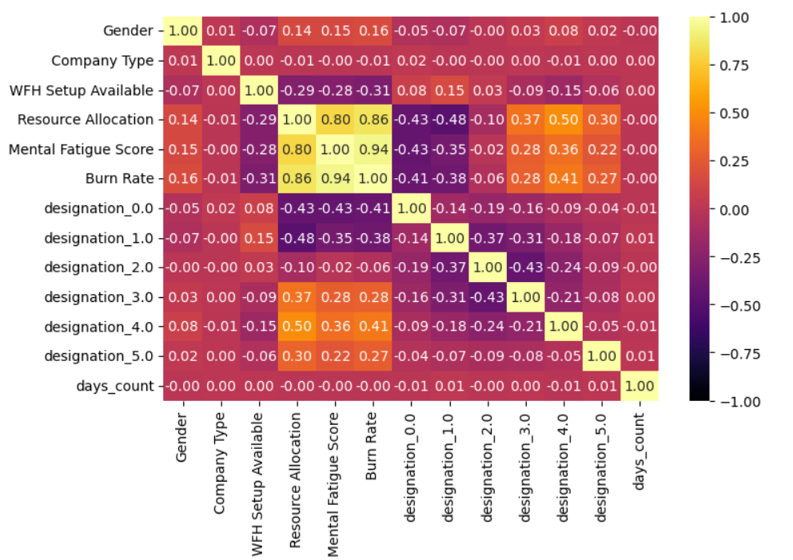

Heat-Map
Primary Predictors
Resource Allocation
Mental Fatigue Score
$$\text{(}\text{Designation}\text{ 3, 4, 5) ∝ }\text{Burn} \text{rate}$$
$$(WFH Setup, Designation 0, Designation 1) ∝ \frac{1}{Burn Rate}$$
Non- Significant
Gender
Company Type
Days Count

Slide 15
Table of Contents
Problem Statement
Overview of Data
Modelling
Conclusion
Notes:
This is the overall reason why we choose this topic.

Slide 16
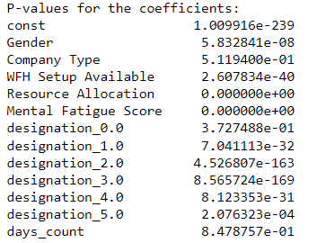
Linear Regression consider p value - Model Fitting and Evaluation
Entire Training Data
Fitted Linear Regression Model
Retained 9 features
p value
Dropped 3 features
* Company Type
* Designation 0.0
* Days Count
Training RMSE | 0.0552
Test RMSE | 0.0547
Error % | 12.10%
Evaluation

Slide 17
Lasso Regression - Model Fitting and Evaluation
Entire Training Data
Grid Search Lasso
Fitted Linear Regression Model
CV - 5
Best alpha: 0.01
Features considered
Entire Training Data
* Resource allocation
* Mental Fatigue Score
Training RMSE | 0.057
Test RMSE | 0.056
Error % | 12.44%
Evaluation​

Slide 18
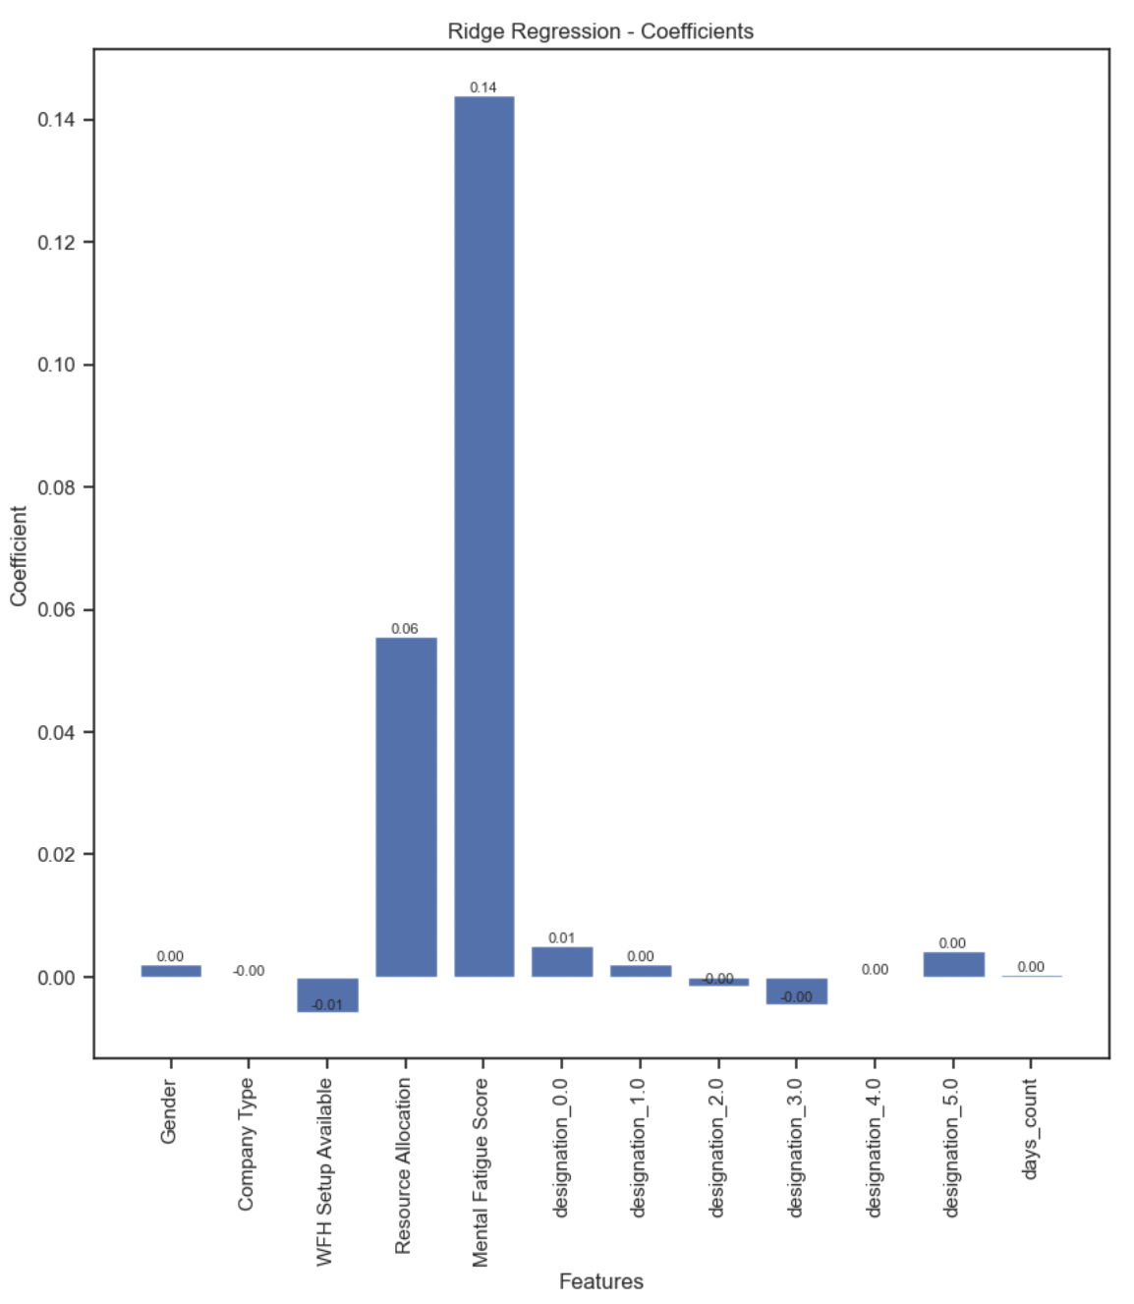
Ridge Regression - Model Fitting and Evaluation
Entire Training Data
Grid Search Ridge
Fitted Linear Regression Model
CV - 5
Best alpha: 1
Training RMSE​ | 0.0552​
Test RMSE​ | 0.0548​
Error %​ | 12.17%​
Evaluation

Slide 19
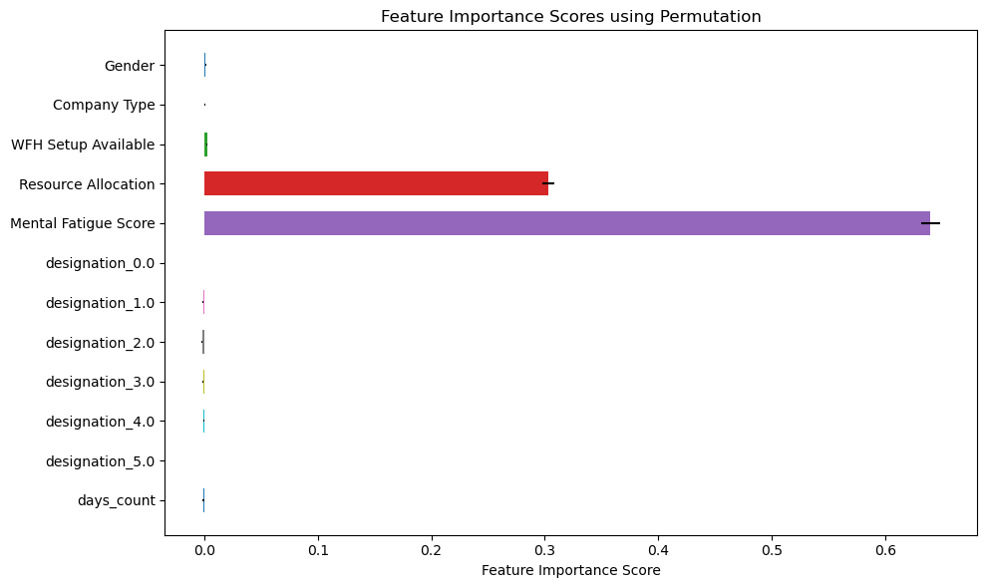
KNN - Model Fitting and Evaluation
Optimal K=9 from 5-fold CV
Entire Training Data
Fitted KNN Model
Training RMSE | 0.062
Test RMSE | 0.066
Error % | 14.6%
Evaluation

Slide 20
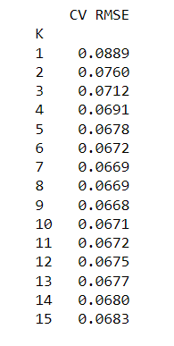
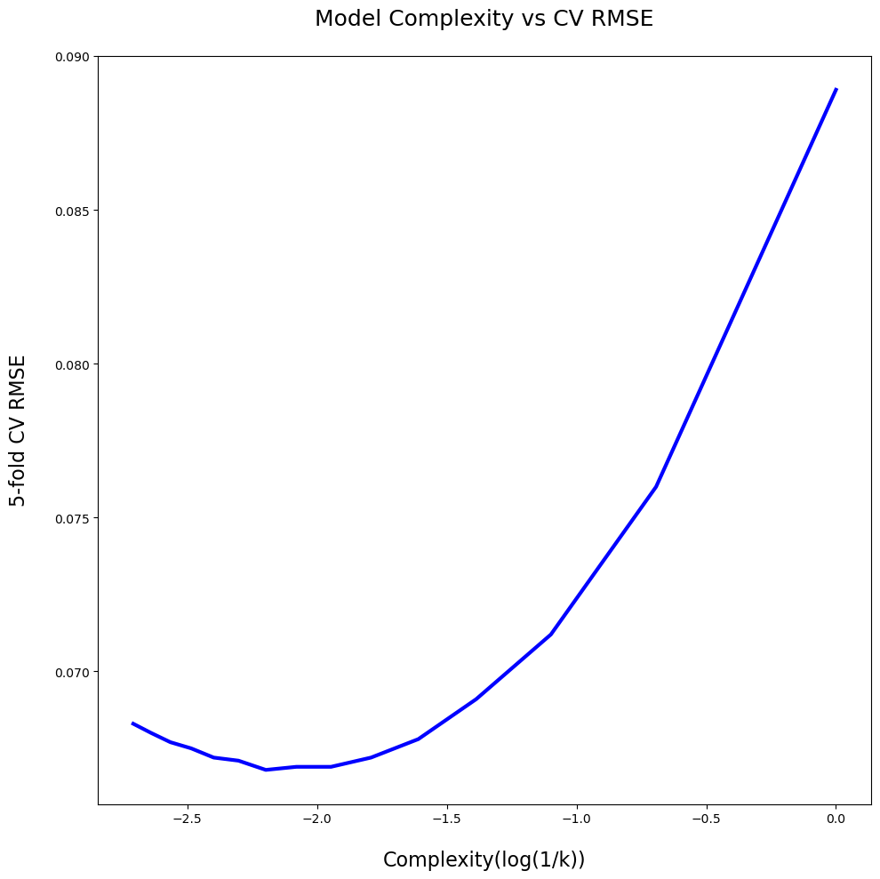
KNN - Model Fitting and Evaluation
5-fold Cross Validation

Slide 21
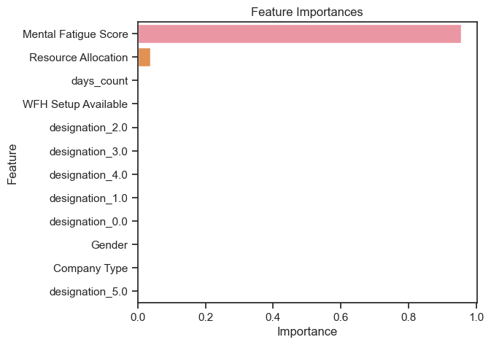
Decision Tree
Entire Training Data
Grid Search CV
Best parameters
Max Depth=8
Min samples leaf=4
Min samples split=10
Folds=5
Training RMSE | 0.052
Test RMSE | 0.055
Error % | 12.16%

Slide 22
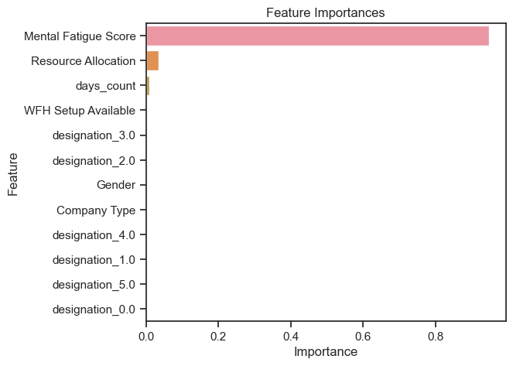
Random Forest
Entire Training Data
Grid Search CV
Best parameters
Max Depth=8
Max Features=12
N estimators=100
Min samples leaf=2
Min samples split=10
Folds=5
Training RMSE | 0.051
Test RMSE | 0.053
Error % | 11.79%

Slide 23
Table of Contents
Problem Statement
Overview of Data
Modelling
Conclusion
Notes:
This is the overall reason why we choose this topic.

Slide 24
Model Comparision
Model | Training RMSE | Test RMSE | Error % | Parameters
Linear Regression (p-values) | 0.0552 | 0.0547 | 12.10% | 3 features dropped
Lasso | 0.057 | 0.056 | 12.44% | 2 features selected
Ridge | 0.0552 | 0.0548 | 12.17% | All features selected
KNN | 0.062 | 0.066 | 14.6 % | Optimal K = 9
Decision Tree | 0.052 | 0.055 | 12.16% | Max Depth=8 N estimators=100 Min samples leaf=4 Min samples split=10
Random Forest | 0.051 | 0.053 | 11.79% | Max Depth=8 Max Features=12 N estimators=100 Min samples leaf=2 Min samples split=2
Notes:
Recall is more important because it's preferable to have a model that does not miss any churns but sometimes classify a non-churns as churns, than a model that does not classify non-churns as churns but misses a lot of churns

Slide 25
Predicting Burnout Rate for a few employees from RF model
Burn Rate 26.17%
Burn Rate 39.21%
Burn Rate 86.59%
Gender | Male
Company Type | Service
WFH Setup | Yes
Billed Hours | 2.0
Mental Fatigue Score | 3.9
Designation | 1.0
Days Count | 203
Gender | Female
Company Type | Service
WFH Setup | Yes
Billed Hours | 5.0
Mental Fatigue Score | 5.2
Designation | 3.0
Days Count | 3
Gender | Male
Company Type | Product
WFH Setup | Yes
Billed Hours | 10.0
Mental Fatigue Score | 8.8
Designation | 5.0
Days Count | 158

Slide 26



Mental Fatigue Score and Resource Allocation (Billable Hours) are the primary determinants to predict the response variable whereas days_count and gender have little to no effect
Random Forest was the best way to predict burnout rate
CONCLUSION
Recommendation: By focus on mental health programs for employees and reasonable work hours can lead to a lower burn out rates hence enhanced productivity followed by improved business performance for employers.
Notes:
Links: When we talk about growing revenues, we typically focus on customer acquisition—your sales, marketing, and customer onboarding efforts. However, there is another key component of revenue growth: customer retention
https://www.pexels.com/photo/photo-of-people-holding-each-other-s-hands-3184434/

Slide 27
THANK YOU

